Slide 1
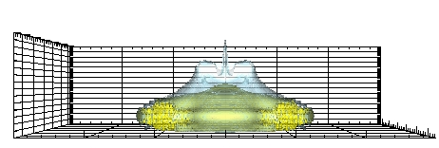
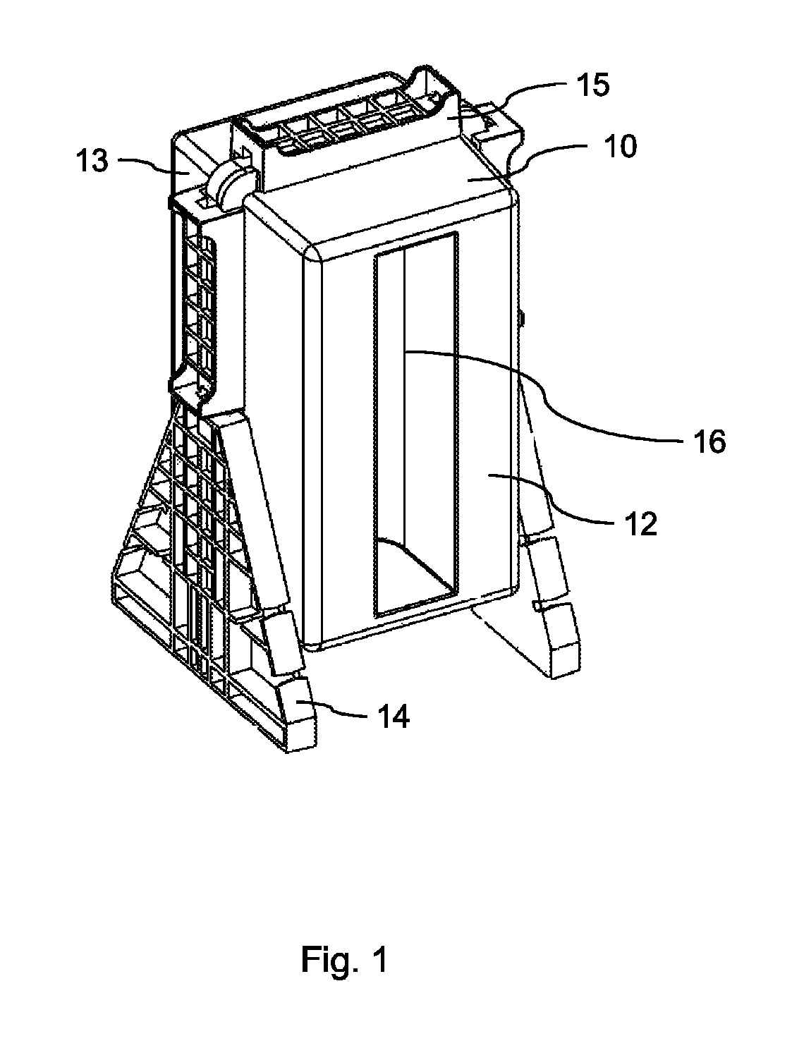
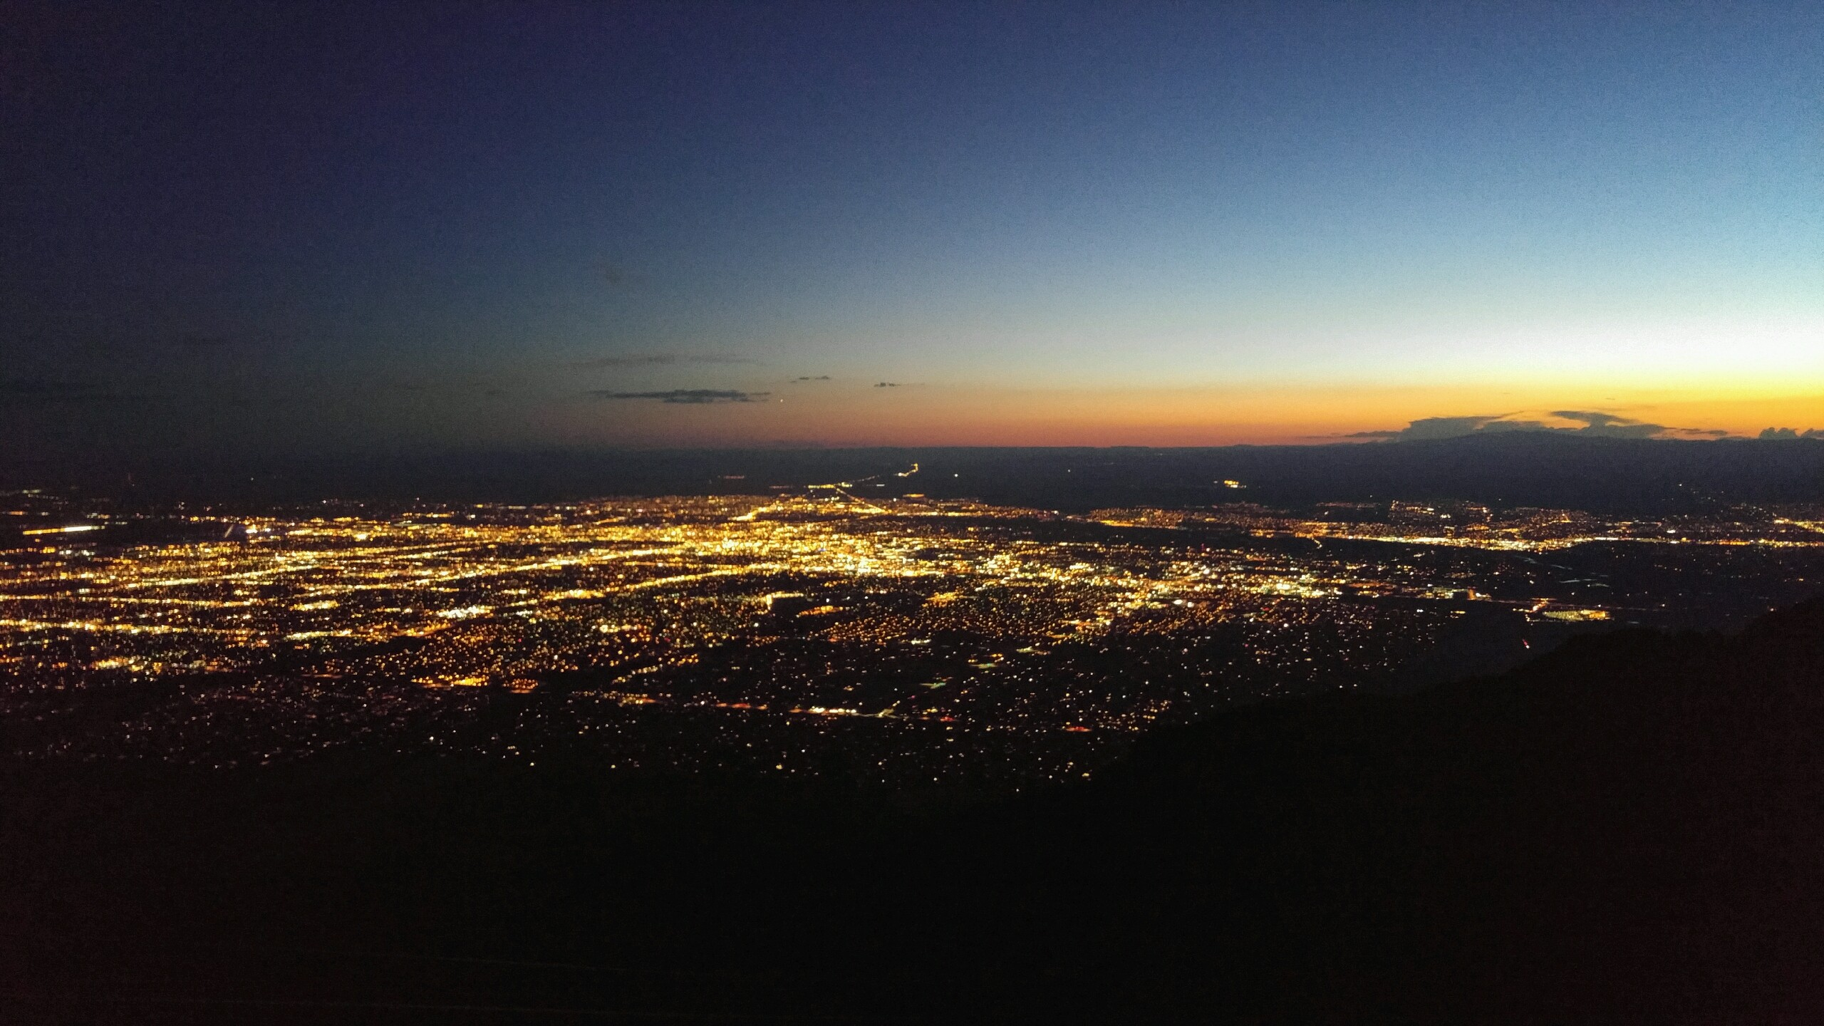
Marc Thomson
1555 / John Pott / John Korbin, David Peterson, and Greg Sharp

Slide 2
Background
University of Colorado at Boulder
Majors in Applied Math, Chemical/Biological Engineering, Minor in History
Interest in field:
No background in solid mechanics!
They say math is useful everywhere, so why not?
Why Sandia?
Pania’s presentation: power of computational models
Prior experience in mathematical modeling
Hobbies:
Hiking, Rock Climbing, Mountain Biking, Reading, Coffee, Stargazing

Slide 3
What did I do?
I developed code that helps run parametrized simulations
I ran simulations to optimize devices.
The code submission is now streamlined and user-friendly. It can also preempt failed simulations and save the user time.
I am converting to year-round, so my projects will continue during the school year

Slide 4
What was my experience like?
Solid Mechanics is much more complicated than I expected.
I loved touring tech area 3. Specifically, I loved the mechanical shock lab
I was trusted to do meaningful work
Never felt like grunt work
I feel accomplishment
I learned a lot about how close the US came to nuclear disaster, and how Sandians helped prevent it.

Slide 5
My Most Important Lesson…

